Slide 1
Pathways of the central nervous system.

Slide 2
White matter of the spinal cord
Ascending pathways: sensory information by multi-neuron chains from body up to more rostral regions of CNS
  Dorsal column
  Spinothalamic tracts
  Spinocerebellar tracts
Descending pathways: motor instructions from brain to more caudal regions of the CNS
  Pyramidal (corticospinal) most important to know
  All others (“extrapyramidal”)
Commissural fibers: crossing from one side of cord to the other
Most pathways cross (or decussate) at some point
Most synapse two or three times along the way, e.g. in brain stem, thalamus or other

Slide 3
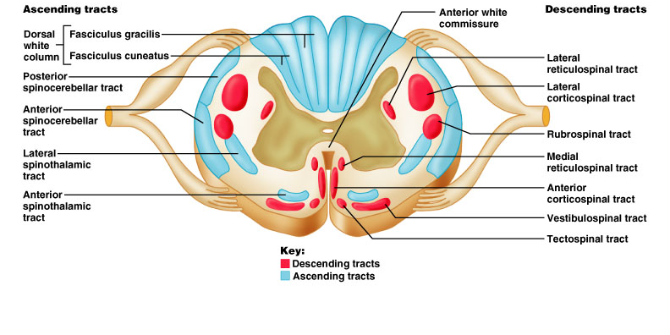
Major fiber tracts in white matter of spinal cord
sensory
motor
Damage: to motor areas – paralysis
to sensory areas - paresthesias

Slide 4
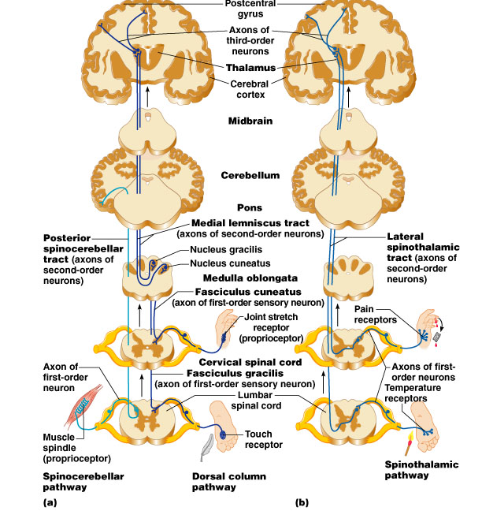
Major ascending pathways for the somatic senses
(thousands of nerve fibers in each)
Spinocerebellar: proprioception from skeletal muscles to cerebellum of same side (don’t cross)
Dorsal column: discriminative touch sensation through thalamus to somatosensory cortex (cross in medulla)
Spinothalamic: carries nondiscriminate sensations (pain, temp, pressure) through the thalamus to the primary somatosensory cortex (cross in spinal cord before ascending)

Slide 5
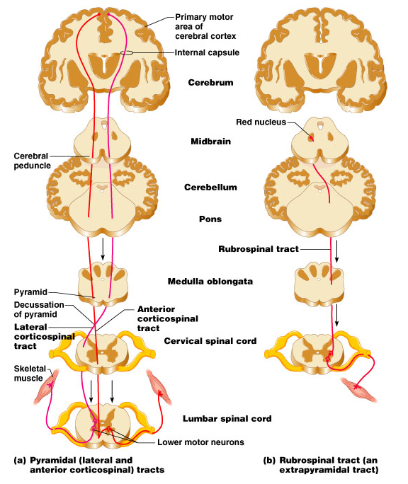
Some Descending Pathways
Synapse with ventral (anterior) horn interneurons
Pyramidal tracts:
Lateral corticospinal – cross in pyramids of medulla; voluntary motor to limb muscles
Ventral (anterior) corticospinal – cross at spinal cord; voluntary to axial muscles
“Extrapyramidal” tracts: one example

Slide 6
Check out: Medical gross anatomy atlas images (good teaching pics):
http://anatomy.med.umich.edu/atlas/atlas_index.html
(can access from Paul Wissman’s site also:
-anatomy and physiology
-brain and spinal cord
-brain pics at U. Mich)
Really good site for photos of human brain dissections:
http://library.med.utah.edu/WebPath/HISTHTML/NEURANAT/NEURANCA.html

Slide 7
Hints & additional pics
Unless your prints of the slides are very large and clear, look at the pictures from the book on your computer screen or in the book itself so you can read all the labels
Anything in bold, italicized or repeated should be learned
Remembering the terminology from the quiz will help you figure things out
Anterior horn cells = ventral motor neurons
Forget funiculi; know dorsal column (spinal cord)

Slide 8
Know the names of the ventricles and which ones connect to which, in order
You don’t need to know the #s of the Brodman areas
You do need to know where are the: primary somatosensory, primary motor, broca’s speech, visual cortex, the lobes of the brain, main sulci and fissures, precentral and postcentral gyri and which go with which of motor and sensory, etc
For the most part, the medical info is FYI

