Slide 1
Functional brain systems
(as opposed to anatomical ones)
Networks of distant neurons that function together
Anatomy of nonspecific brain systems: reticular formation and limbic system. Features of blood supply to the brain and cerebrospinal fluid dynamics

Slide 2
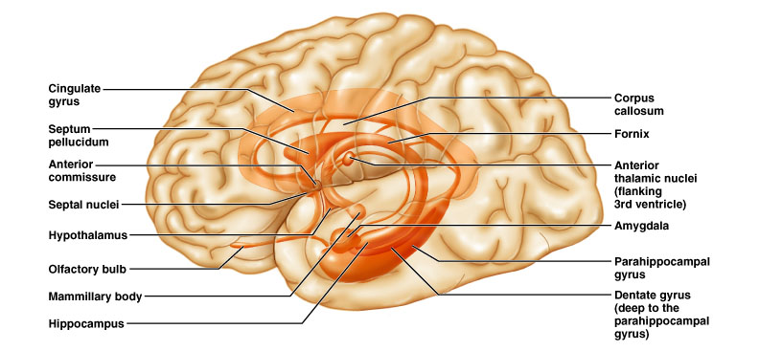
Limbic system
(not a discrete structure - includes many brain areas)
Most important parts:
  Hipocampus
  Amygdala
  Cingulate gyrus
  Orbitofrontal cortex (not labeled; is behind eyes - part of the prefrontal cortex but connects closely)

Slide 3
Limbic system continued
Called the “emotional” brain
Is essential for flexible, stable, adaptive functioning
Links different areas so integration can occur
  Integration: separate things are brought together as a whole
  Processes emotions and allocates attentional resources
Necessary for emotional balance, adaptation to environmental demands (including fearful situations, etc.), for creating meaningful connections with others (e.g. ability to interpret facial expressions and respond appropriately), and more…

Slide 4
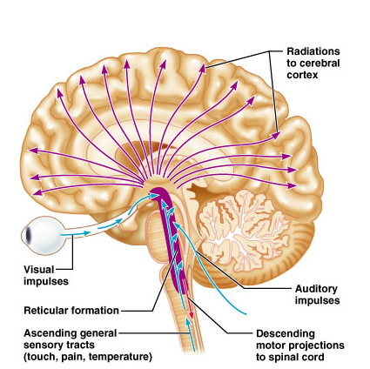
Reticular formation
  Runs through central core of medulla, pons and midbrain
Reticular activating
system (RAS):
keeps the cerebral
cortex alert and
conscious
Some motor control

Slide 5
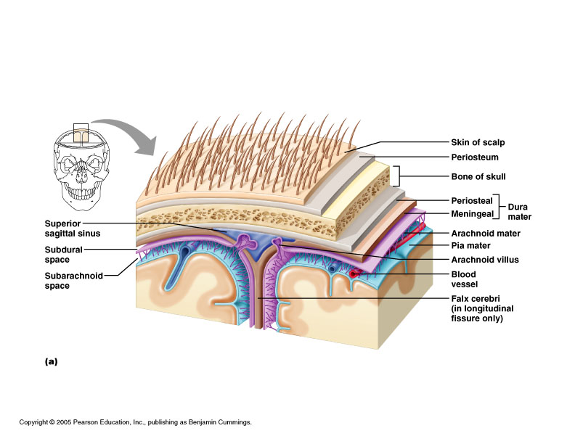
Brain protection
1.Meninges
2. Cerebrospinal fluid
3. Blood brain barrier

Slide 6
Meninges
Dura mater: 2 layers of fibrous connective tissue, fused except for dural sinuses
  Periosteal layer attached to bone
  Meningeal layer - proper brain covering
Arachnoid mater
Pia mater
Note superior
sagittal sinus

Slide 7
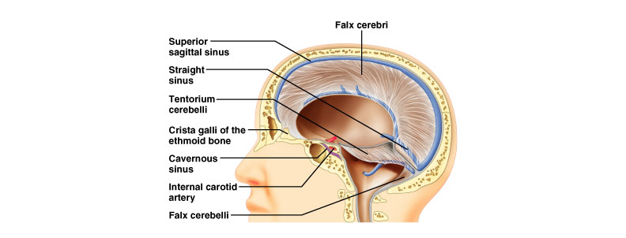
Dura mater - dural partitions
Subdivide cranial cavity & limit movement of brain
Falx cerebri
  In longitudinal fissure; attaches to crista galli of ethmoid bone
Falx cerebelli
  Runs vertically along vermis of cerebellum
Tentorium cerebelli
  Sheet in transverse fissure between cerebrum & cerebellum

Slide 8
Arachnoid mater
  Between dura and arachnoid: subdural space
  Dura and arachnoid cover brain loosely
  Deep to arachnoid is subarachnoid space
    Filled with CSF
    Lots of vessels run through (susceptible to tearing)
  Superiorly, forms arachnoid villi: CSF valves
    Allow draining into dural blood sinuses
Pia mater
  Delicate, clings to brain following convolutions

Slide 9
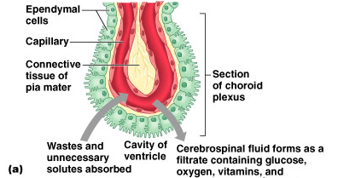
Cerebrospinal Fluid
CSF
Made in choroid plexuses (roofs of ventricles)
  Filtration of plasma from capillaries through ependymal cells (electrolytes, glucose)
500 ml/d; total volume 100-160 ml (1/2 c)
Cushions and nourishes brain
Assayed in diagnosing meningitis, bleeds, MS
Hydrocephalus: excessive accumulation

Slide 10
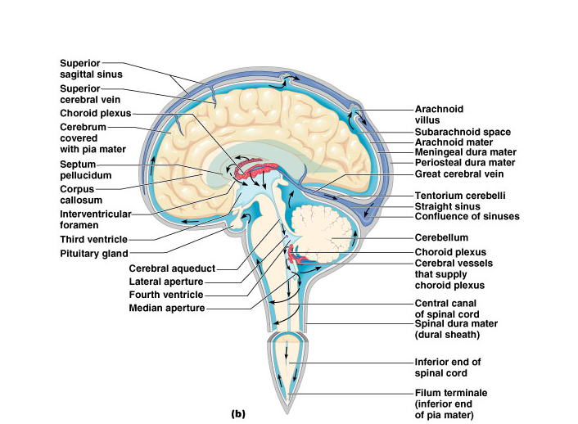
CSF circulation: through ventricles, median and lateral apertures, subarachnoid space, arachnoid villi, and into the blood of the superior sagittal sinus
CSF:
-Made in choroid plexus
-Drained through arachnoid villus

Slide 11
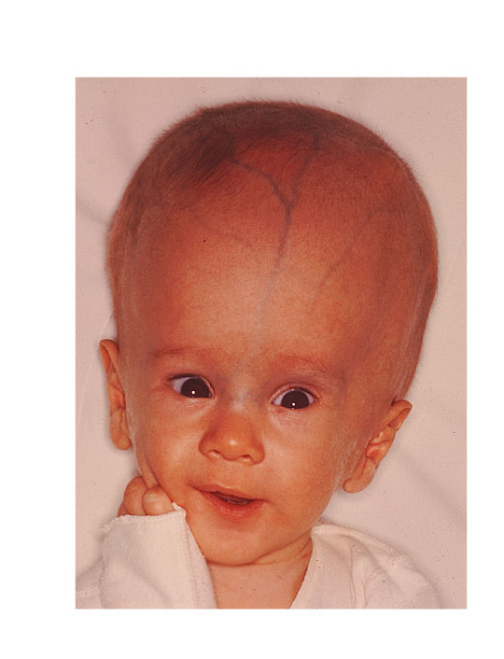
Hydrocephalus

Slide 12
Blood-Brain Barrier
Tight junctions between endothelial cells of brain capillaries, instead of the usual permeability
Highly selective transport mechanisms
Allows nutrients, O2, CO2
Not a barrier against uncharged and lipid soluble molecules; allows alcohol, nicotine, and some drugs including anesthetics

